Slide 1
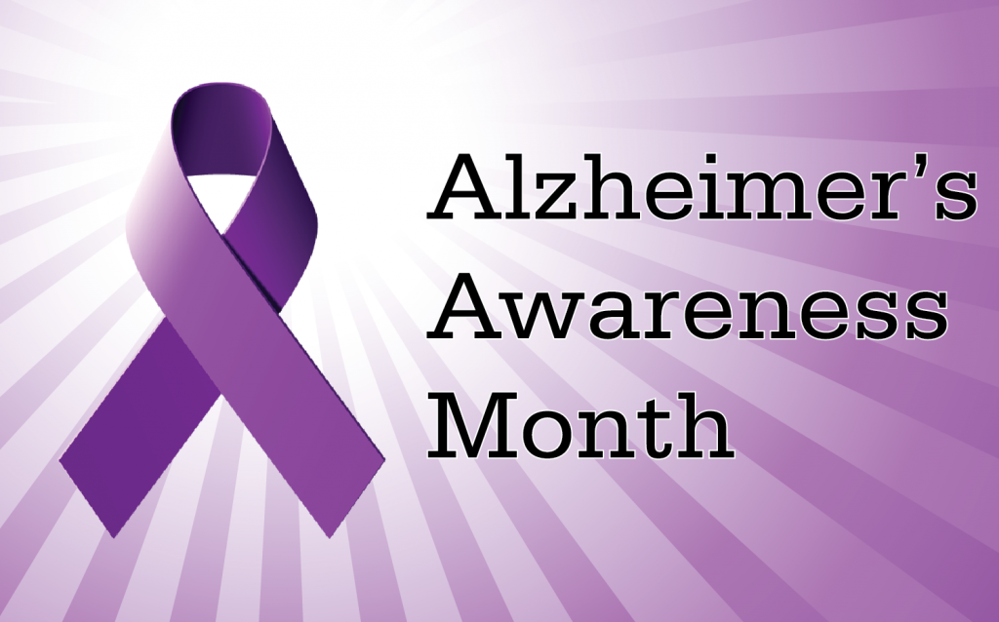
This Photo by Unknown Author is licensed under CC BY-SA

Slide 2
October is Alzheimer’s awareness month. Purple Sunday is Sponsored by the Alzheimer’s Association in Cleveland Ohio and the greater East Ohio Area chapter. It was designed to educate members of the faith community about Alzheimer’s Disease and others Dementias.
How many of you have been impacted by Alzheimer’s Disease or another type of Dementia?
How can we change our life style to affect our health?
If you see signs of memory loss in a loved one, take action and seek a diagnoses, it is important to start treatment of the disease early

Slide 3
Alzheimer's and Dementia Disease Worldwide, 55 million people are living with Alzheimer's and other Dementias. Alzheimer’s disease is a brain disease that gets worse over time. It’s characterized by changes in the brain that lead to deposits of certain abnormal proteins (Amyloids) that builds up in the brain. Alzheimer’s causes the brain to shrink over time, and brain cell eventually die. Alzheimer’s disease is a degenerative brain disease and the most common form of dementia-a gradual decline in memory, thinking, behavioral and social skills. These changes affects a person’s ability to function. This Disease is not a part of the normal aging process. Dementia is not a specific disease. It's an overall term that describes a group of symptoms.

Slide 4
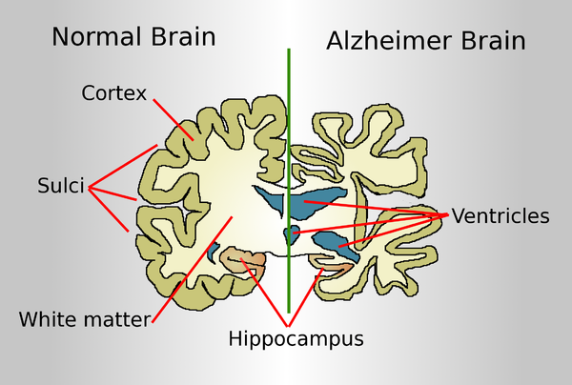
This Photo by Unknown Author is licensed under CC BY-SA

Slide 5
10 Early Signs and Symptoms of Alzheimer's and Dementia
Memory loss that disrupts daily life. Alzheimer's is a brain disease that causes a slow decline in memory, thinking and reasoning skills. There are 10 warning signs and symptoms. If you notice any of them, don't ignore them. Schedule an appointment with your doctor.
One of the most common signs of Alzheimer’s disease, especially in the early stage, is forgetting recently learned information. Others include forgetting important dates or events, asking the same questions over and over, and increasingly needing to rely on memory aids (e.g., reminder notes or electronic devices) or family members for things they used to handle on their own.
What's a typical age-related change? Sometimes forgetting names or appointments, but remembering them later.

Slide 6
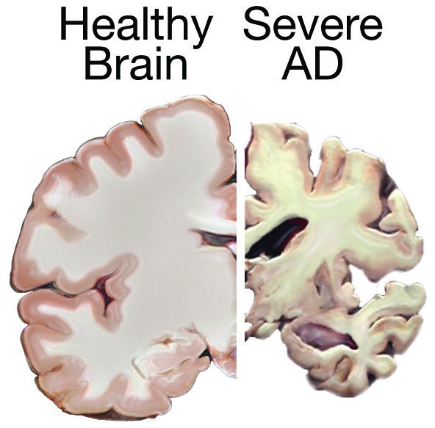

Slide 7
Challenges in planning or solving problems
Some people living with changes in their memory due to Alzheimer's or other dementia may experience changes in their ability to develop and follow a plan or work with numbers. They may have trouble following a familiar recipe or keeping track of monthly bills. They may also have difficulty concentrating, and it may take much longer to do things than they did before.
What's a typical age-related change?
Making occasional errors when managing finances or household bills.
Challenges in planning or solving problems
Some people living with changes in their memory due to Alzheimer's or other dementia may experience changes in their ability to develop and follow a plan or work with numbers. They may have trouble following a familiar recipe or keeping track of monthly bills. They may have difficulty concentrating and take much longer to do many things than they did before.

Slide 8
Confusion with time or place
People living with Alzheimer's or other dementia can lose track of dates, seasons and the passage of
time. They may have trouble understanding something if it is not happening immediately. Sometimes
they may forget where they are or how they got there.
What's a typical age-related change? Getting confused about the day of the week but figuring it out later.
Trouble understanding visual images and spatial relationships
Some people living with Alzheimer's or other dementia could experience vision changes. This may lead
to difficulty with balance or trouble reading. They may also have problems judging distance and
determining color or contrast, causing issues with driving.
What's a typical age-related change? Vision changes related to cataracts.

Slide 9
Withdrawal from work or social activities
A person living with Alzheimer’s or other dementia may experience changes in the ability to hold or follow a
conversation. As a result, they may withdraw from hobbies, social activities or other engagements. They may
have trouble keeping up with a favorite team or activity.
What's a typical age-related change? Sometimes feeling uninterested in family or social obligations.
Changes in mood and personality
Individuals living with Alzheimer’s or other dementia may experience mood and personality changes. They
can become confused, suspicious, depressed, fearful or anxious. They may be easily upset at home, with
friends or when out of their comfort zone.
What's a typical age-related change? Developing very specific ways of doing things and becoming irritable when a routine is disrupted.

Slide 10
The difference between Alzheimer’s and typical age-related changes
Signs of Alzheimer's and Dementia | Typical Age-Related Changes
Poor judgment and decision-making | Making a bad decision once in a while
Inability to manage a budget | Missing a monthly payment
Losing track of the date or the season | Forgetting which day it is and remembering it later
Difficulty having a conversation | Sometimes forgetting which word to use
Misplacing things and being unable to retrace steps to find them | Losing things from time to time

Slide 11
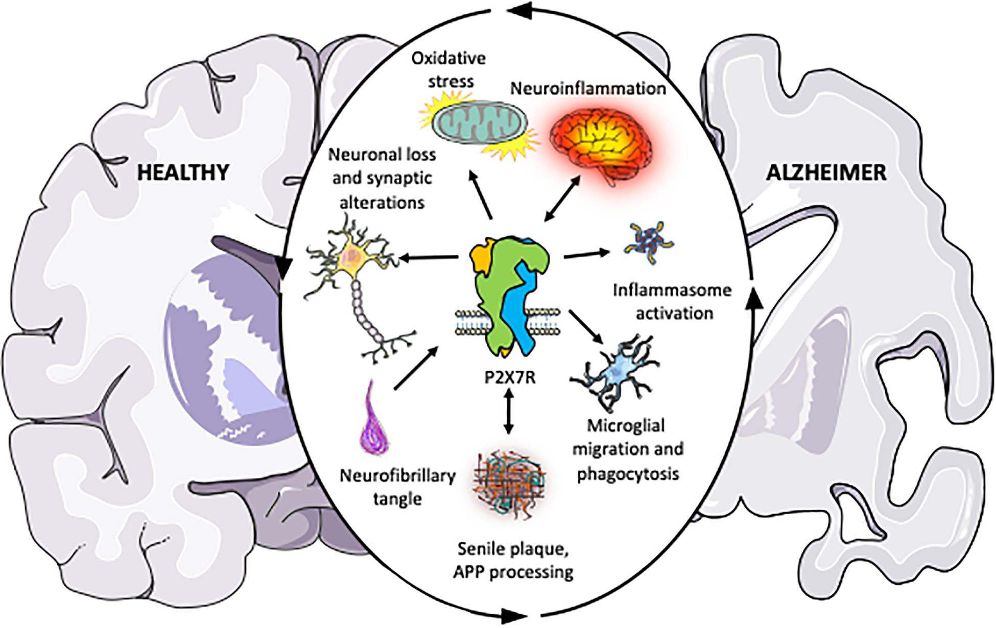
This Photo by Unknown Author is licensed under CC BY

Slide 12
Facts About Alzheimer's Disease
Alzheimer’s Disease is a progressive fatal brain disease that kills nerve cells and brain tissue
Alzheimer’s Disease is a most common type of Dementia
More than six million Americans are living with Alzheimer’s, with over 11 million care givers
1 in 3 seniors die with Alzheimer’s or another Dementia
Almost 2/3 of Americans with Alzheimer’s are women
There is no cure for this disease, medication may slow down the progression of the disease
6.5 million people in the United States live with Alzheimer’s Disease
In the advance stages of Alzheimer’s, severe loss of brain function can cause dehydration, malnutrition or
Infection; which may result in death

Slide 13
References:
Mayo Clinic of Cleveland Ohio, Arizona and Texas
Call our 24/7 Helpline: 800.272.3900
Locate your local Alzheimer's Association
Use our Virtual Library
Go to Alzheimer's Navigator to create customized action plans and connect with local support
services

